Slide 1
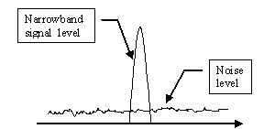
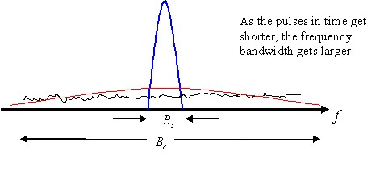
Spread Spectrum
Narrowband signals are easily jammed by any other signal in the same band.
Spread Spectrum refers to a system originally developed for military applications, to provide secure communications by spreading the signal over a large frequency band.
The idea behind spread spectrum is to use more bandwidth than the original message while maintaining the same signal power.
A spread spectrum signal does not have a clearly distinguishable peak in the spectrum which makes the signal more difficult to distinguish from noise and therefore more difficult to jam or intercept.
There are two predominant techniques to spread the spectrum: 1) Frequency hoping (FH) 2) Direct sequence (DS)

Slide 2
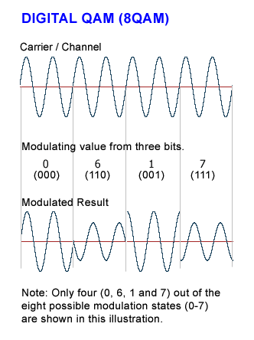
QAM
QAM (quadrature amplitude modulation) involves sending digital information by periodically adjusting the phase and amplitude of a sinusoidal electromagnetic wave. Each combination of phase and amplitude is called a symbol and represents a digital bitstream.
A variety of communication protocols implement QAM such as 802.11b wireless Ethernet (Wi-Fi) utilize 64-QAM modulation.
QAM requires changing the phase and amplitude of a carrier sine wave. One of the easiest ways to implement QAM with hardware is to generate and mix two sine waves that are 90 degrees out of phase with one another. Adjusting only the amplitude of either signal can affect the phase and amplitude of the resulting mixed signal.

Slide 3
4-3 TRANSMISSION MODES
The transmission of binary data across a link can be accomplished in either parallel or serial mode. In parallel mode, multiple bits are sent with each clock tick. In serial mode, 1 bit is sent with each clock tick. While there is only one way to send parallel data, there are three subclasses of serial transmission: asynchronous, synchronous, and isochronous.
Topics discussed in this section:
Parallel Transmission
Serial Transmission

Slide 4
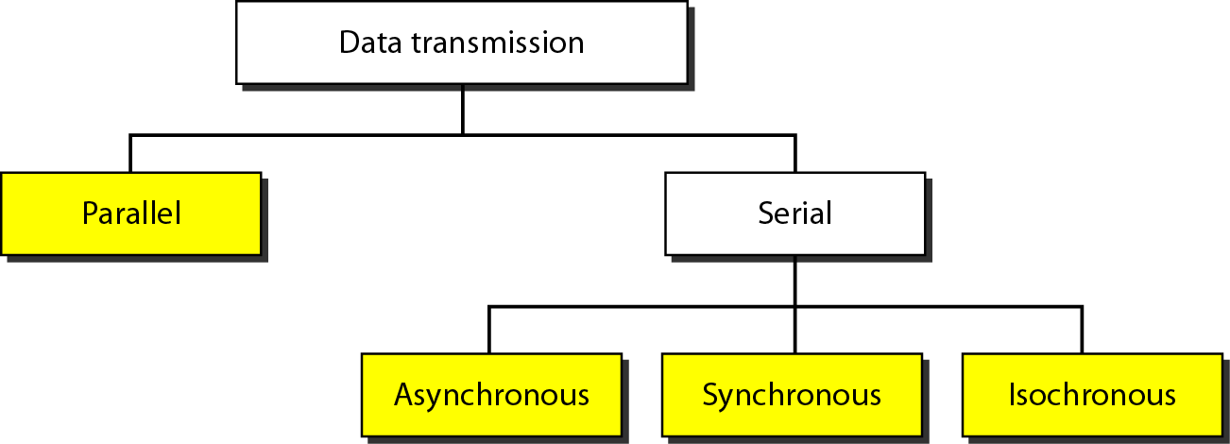
Figure 4.31 Data transmission and modes

Slide 5
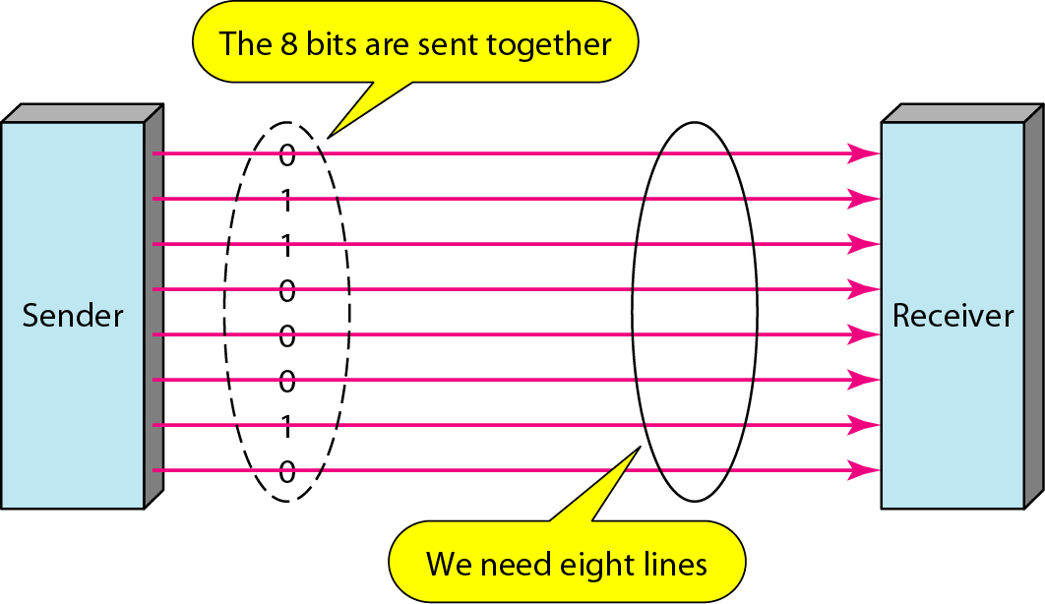
Figure 4.32 Parallel transmission

Slide 6
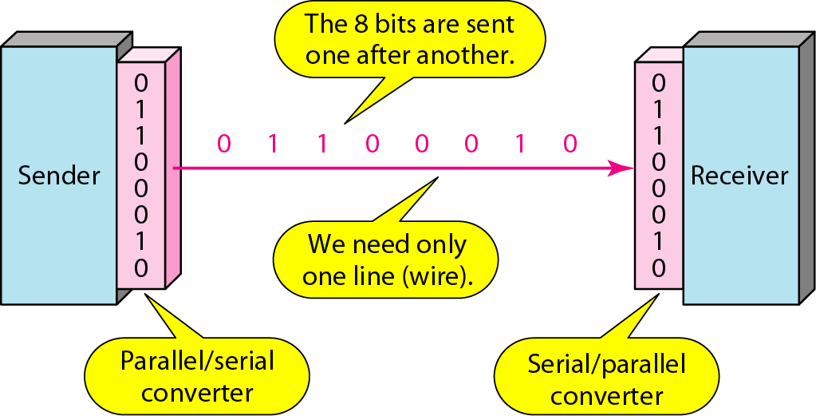
Figure 4.33 Serial transmission

Slide 7

Note
In asynchronous transmission, we send 1 start bit (0) at the beginning and 1 or more stop bits (1s) at the end of each byte. There may be a gap between each byte.

Slide 8
Note
Asynchronous here means “asynchronous at the byte level,”
but the bits are still synchronized; their durations are the same.

Slide 9
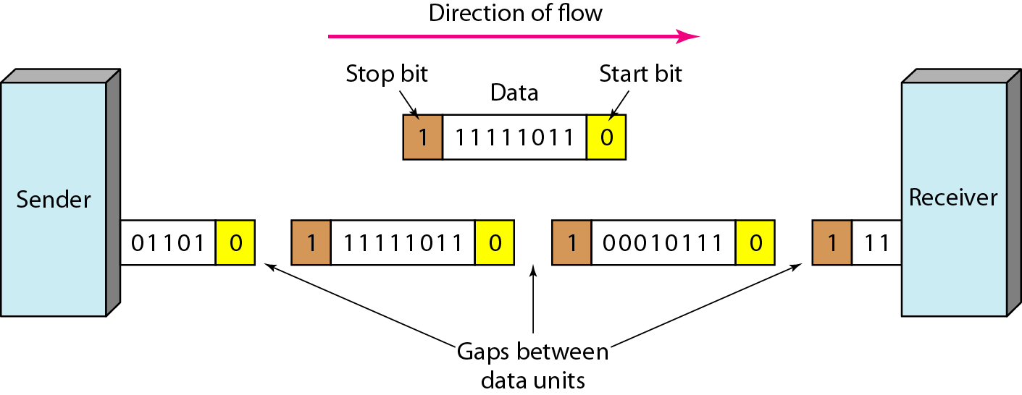
Figure 4.34 Asynchronous transmission

Slide 10
Note
In synchronous transmission, we send bits one after another without start or stop bits or gaps. It is the responsibility of the receiver to group the bits. The bits are usually sent as bytes and many bytes are grouped in a frame. A frame is identified with a start and an end byte.

Slide 11
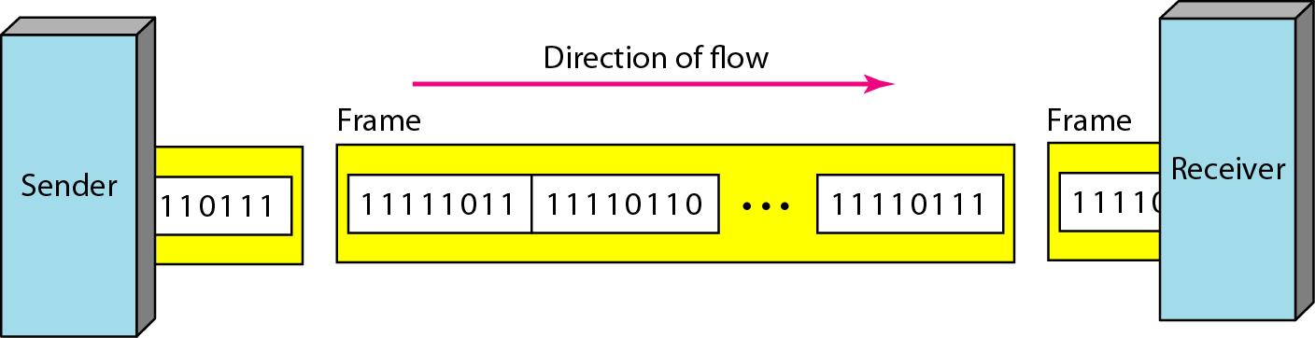
Figure 4.35 Synchronous transmission

Slide 12
Isochronous
In isochronous transmission we cannot have uneven gaps between frames.
Transmission of bits is fixed with equal gaps.

